Slide 1
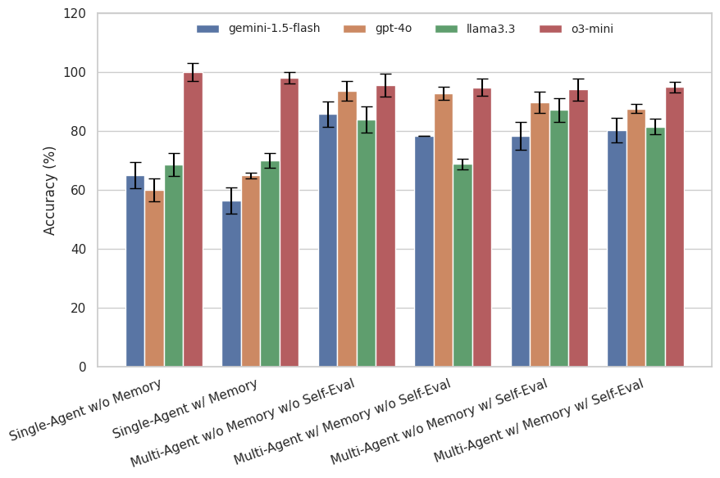
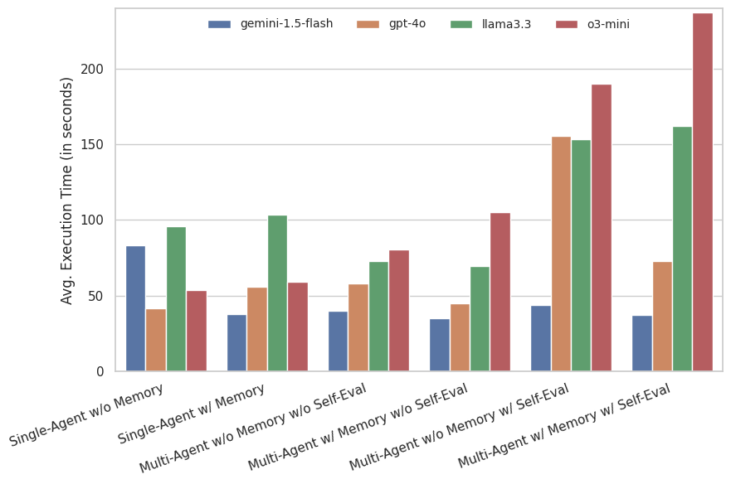
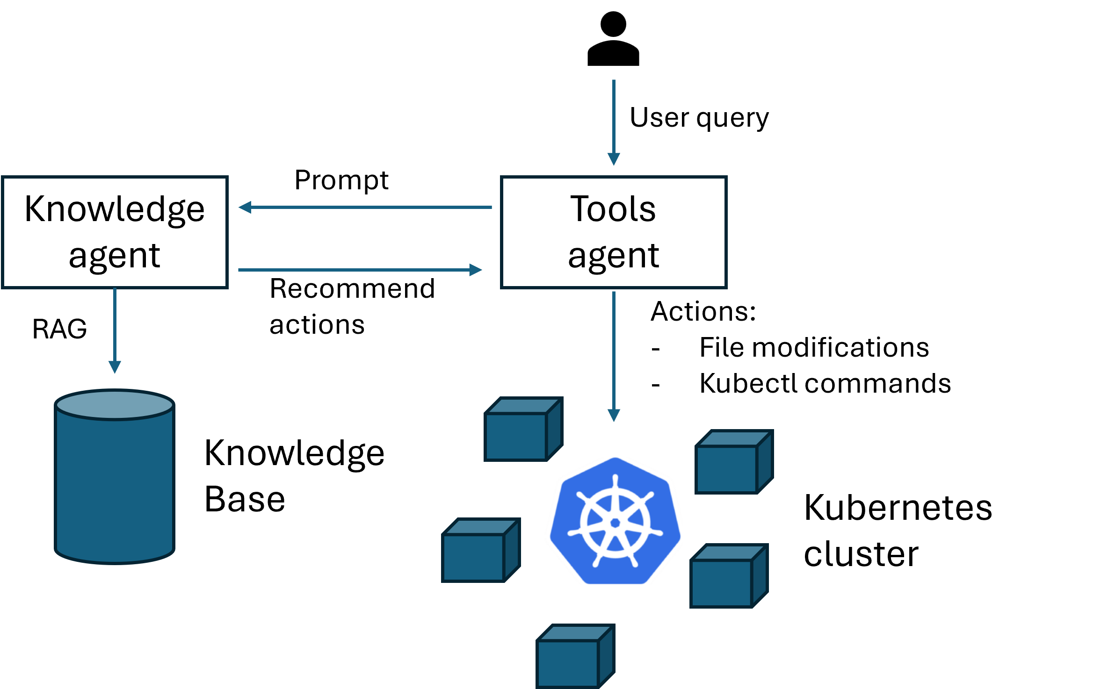


Multi-Agent LLM Framework For Troubleshooting Distributed Systems
Mario De Jesus, Perfect Sylvester, William Clifford, Aaron Perez, and Palden Lama The University of Texas at San Antonio
Abstract
Evaluation
Effectively configuring distributed systems either in cloud or edge is challenging due to the complexity of application deployment and orchestration. In this project, we developed KubeLLM, a multi-agent LLM framework designed to manage a testbed of distributed nodes, debug configuration errors, and analyze the root cause of performance issues. Our preliminary study shows the feasibility of KubeLLM. We conducted performance benchmarking and analysis on a single server hosting Docker containers to emulate multiple compute nodes, with Kubernetes orchestrating the environment.
Testbed & Tools
Physical server hosting KubeLLM and Kubernetes cluster
2 Intel(R) Xeon(R) Gold 6338 (32 cores each) 768GB RAM
2 Nvidia A40 GPUs (46GB) VRAM
Phidata framework for developing LLM agents
Kubernetes (v1.31.5) for container orchestration
Kubernetes Cluster Troubleshooting with LLM Agents
Introduction
• Motivation
Distributed computing systems can be complex or tedious to configure
While automation tools like Ansible exist, effectively utilizing such tools itself has a steep learning curve and is error-prone.
Automation of configuration management and troubleshooting will enable engineers to focus more on development rather than routine support tasks.
Contributions
We developed KubeLLM, a multi-agent LLM framework to manage a Kubernetes cluster. The agent is developed using the Phidata framework with the flexibility to utilize various models including Llama, Open AI GPT 4o, Google Gemini, etc.
KubeLLM takes actions using Linux shell commands, remembers chat history, and utilizes domain-specific knowledge acquired through Retrieval Augmented Generation (RAG).
KubeLLM is lightweight and easily deployable on resource constrained edge devices.
We developed KubeLLMBench, a benchmarking framework designed to evaluate LLM agents in diagnosing and resolving various Kubernetes configuration issues.
Experimental evaluation on our Kubernetes testbed demonstrates the effectiveness of our LLM agents.
Fig. 1 Average Accuracy with Different Models & Approaches
Methods
KubeLLM Architecture
Fig. 2 Average Execution Time with Different Models & Approaches
Approach | Model | environment_variable | incorrect_selector | liveness_probe | misspelling | port_mismatch | volume_mount | wrong_interface | wrong_port
Multi-Agent w/ Memory w/o Self-Eval | gemini-1.5-flash | 0.0% / 17.3s | 60.0% / 38.4s | 100.0% / 16.7s | 42.11% / 19.0s | 100.0% / 26.2s | 100.0% / 17.6s | 100.0% / 56.5s | 100.0% / 49.2s
 | gpt-4o | 100.0% / 36.7s | 100.0% / 17.2s | --- | 60.0% / 46.6s | 100.0% / 16.1s | 100.0% / 37.1s | 100.0% / 97.9s | 100.0% / 54.9s
 | llama3.3 | 0.0% / 46.8s | 0.0% / 60.7s | 100.0% / 22.6s | 45.0% / 63.2s | 100.0% / 73.5s | 100.0% / 58.2s | 100.0% / 76.2s | 100.0% / 85.1s
 | o3-mini | 95.0% / 97.9s | 75.0% / 140.9s | 100.0% / 99.3s | 90.0% / 70.8s | 100.0% / 86.3s | 100.0% / 113.0s | 100.0% / 89.6s | 100.0% / 144.8s
Multi-Agent w/ Memory w/ Self-Eval | gemini-1.5-flash | 0.0% / 13.7s | 75.0% / 21.6s | 100.0% / 18.5s | 30.0% / 29.2s | 100.0% / 14.6s | 100.0% / 21.5s | 100.0% / 72.9s | 100.0% / 87.3s
 | gpt-4o | 70.59% / 39.9s | 80.0% / 27.4s | 100.0% / 147.4s | 70.0% / 66.0s | 95.0% / 59.7s | 100.0% / 39.8s | 100.0% / 125.4s | 100.0% / 115.8s
 | llama3.3 | 0.0% / 65.8s | 65.0% / 163.3s | 100.0% / 88.4s | 60.0% / 224.9s | 100.0% / 130.6s | 100.0% / 45.2s | 100.0% / 245.8s | 100.0% / 169.5s
 | o3-mini | 95.0% / 321.2s | 85.0% / 73.8s | 100.0% / 362.1s | 80.0% / 315.8s | 100.0% / 105.7s | 100.0% / 190.0s | 100.0% / 290.5s | 100.0% / 255.1s
Multi-Agent w/o Memory w/o Self-Eval | gemini-1.5-flash | 0.0% / 20.5s | 95.0% / 29.5s | --- | 55.0% / 22.2s | 95.0% / 32.4s | 100.0% / 21.5s | 100.0% / 83.7s | 100.0% / 47.9s
 | gpt-4o | 100.0% / 104.7s | 100.0% / 35.0s | --- | 70.0% / 24.4s | 90.0% / 36.8s | 100.0% / 23.3s | 100.0% / 83.6s | 100.0% / 95.4s
 | llama3.3 | 0.0% / 46.1s | 100.0% / 64.6s | --- | 35.0% / 58.8s | 100.0% / 88.3s | 100.0% / 51.9s | 100.0% / 81.3s | 100.0% / 84.3s
 | o3-mini | 100.0% / 88.8s | 90.0% / 100.4s | 100.0% / 88.4s | 75.0% / 48.5s | 100.0% / 68.7s | 100.0% / 81.9s | 100.0% / 78.1s | 100.0% / 88.1s
Multi-Agent w/o Memory w/ Self-Eval | gemini-1.5-flash | 28.57% / 21.0s | 90.0% / 35.1s | 100.0% / 27.5s | 20.0% / 30.6s | 100.0% / 26.8s | 100.0% / 67.3s | 100.0% / 75.1s | 100.0% / 78.6s
 | gpt-4o | 82.35% / 119.2s | 95.0% / 109.8s | 100.0% / 127.4s | 55.0% / 82.6s | 100.0% / 107.3s | 100.0% / 51.4s | 100.0% / 430.6s | 100.0% / 238.4s
 | llama3.3 | 0.0% / 61.5s | 95.0% / 183.3s | 100.0% / 56.6s | 70.0% / 177.4s | 95.0% / 99.3s | 100.0% / 102.2s | 100.0% / 216.2s | 100.0% / 195.0s
 | o3-mini | 90.0% / 104.7s | 85.0% / 87.5s | 100.0% / 313.4s | 85.0% / 175.1s | 95.0% / 121.3s | 100.0% / 123.3s | 100.0% / 282.3s | 100.0% / 359.1s
Single-Agent w/ Memory | gemini-1.5-flash | 0.0% / 7.0s | 45.0% / 76.0s | 100.0% / 19.2s | 0.0% / 4.2s | 100.0% / 4.3s | 100.0% / 104.5s | --- | 100.0% / 10.7s
 | gpt-4o | 11.76% / 151.5s | 50.0% / 33.2s | 100.0% / 40.7s | 0.0% / 27.0s | 100.0% / 48.0s | 100.0% / 44.4s | 100.0% / 59.4s | ---
 | llama3.3 | 0.0% / 88.6s | 90.0% / 49.2s | 100.0% / 104.4s | 0.0% / 150.6s | 100.0% / 101.2s | 100.0% / 165.7s | --- | 100.0% / 66.1s
 | o3-mini | 100.0% / 42.4s | 94.74% / 77.8s | 100.0% / 52.5s | 95.0% / 58.3s | 95.0% / 59.6s | 100.0% / 62.2s | 100.0% / 70.7s | 100.0% / 50.5s
Single-Agent w/o Memory | gemini-1.5-flash | 0.0% / 177.5s | 100.0% / 4.3s | 100.0% / 43.2s | 0.0% / 6.1s | 95.0% / 4.3s | 100.0% / 253.6s | --- | 100.0% / 90.6s
 | gpt-4o | 0.0% / 26.6s | 25.0% / 16.1s | 100.0% / 44.9s | 25.0% / 19.4s | 100.0% / 90.1s | 100.0% / 44.7s | 100.0% / 63.6s | ---
 | llama3.3 | 5.26% / 106.0s | 95.0% / 61.0s | 100.0% / 106.6s | 15.0% / 102.9s | 95.0% / 122.9s | 100.0% / 74.4s | --- | 100.0% / 130.8s
 | o3-mini | 100.0% / 30.0s | 100.0% / 55.6s | 100.0% / 57.0s | 100.0% / 54.2s | 100.0% / 52.7s | 100.0% / 59.8s | 100.0% / 63.7s | 100.0% / 93.4s
KubeLLM Design
KubeLLM features a multi-agent architecture where an LLM agent, equipped with Linux shell tools, interacts with a RAG-based knowledge agent to diagnose Kubernetes configuration issues and apply necessary fixes.
Each agent in KubeLLM can be configured to utilize both proprietary LLMs via remote access and lightweight open-source LLMs hosted locally on a nearby edge server.
We developed KubeLLMBench, a benchmark suite designed to evaluate LLM agents in diagnosing and resolving various Kubernetes configuration issues.
We evaluated various modes of multi-agent interaction
(1) w/o self-eval: the tools agent takes all actions suggested by the knowledge agent in a single interaction.
(2) w/ self-eval: the tools agent takes one action at a time, evaluates the impact of the action and asks the knowledge agent to suggest further actions.
(3) w/o memory: both agents have no memory
(4) w memory: both agents remember chat history
Table 1 Performance of various models and approaches at task-level granularity.
Conclusions
The KubeLLM framework using OpenAI GPT4o, Gemini-1.5-flash, O3-mini, Llama-3.3 can successfully perform many tasks associated with troubleshooting a Kubernetes cluster.
The Multi-agent framework significantly improves the accuracy of most models, while slightly degrades the accuracy of reasoning models like O3-mini.
Acknowledgement: This material is based upon work supported by the U.S Department of Energy, Office of Science, Office of Advanced Scientific Computing Research (ASCR), Reaching a New Energy Sciences Workforce (RENEW) under Award Number DE-SC0024322, and the UTSA School of Data Science Undergraduate Research Fellowship.

